Slide 1
Module 1: Introduction

Slide 2


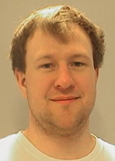
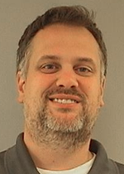
Instructors
Steven Carter
Sandia National Labs Principle Member of Staff
Research Interests: Transfer Path Analysis, MIMO Testing, Inverse Methods
Andreas Linderholt
Linneaus University – Associate Professor – Department of Mechanical Engineering
Research Interests: Dynamic Substructuring, Structural Dynamics
Benjamin Moldenhauer
Sandia National Labs Postdoctoral Appointee
Research Interests: Dynamic Substurctuirng, Nonlinear System Identification
Daniel Roettgen
Sandia National Labs Principle Member of Staff
Research Interests: Dynamic Substurctuirng, Structural Health Monitoring, Nonlinear Dynamics

Slide 3
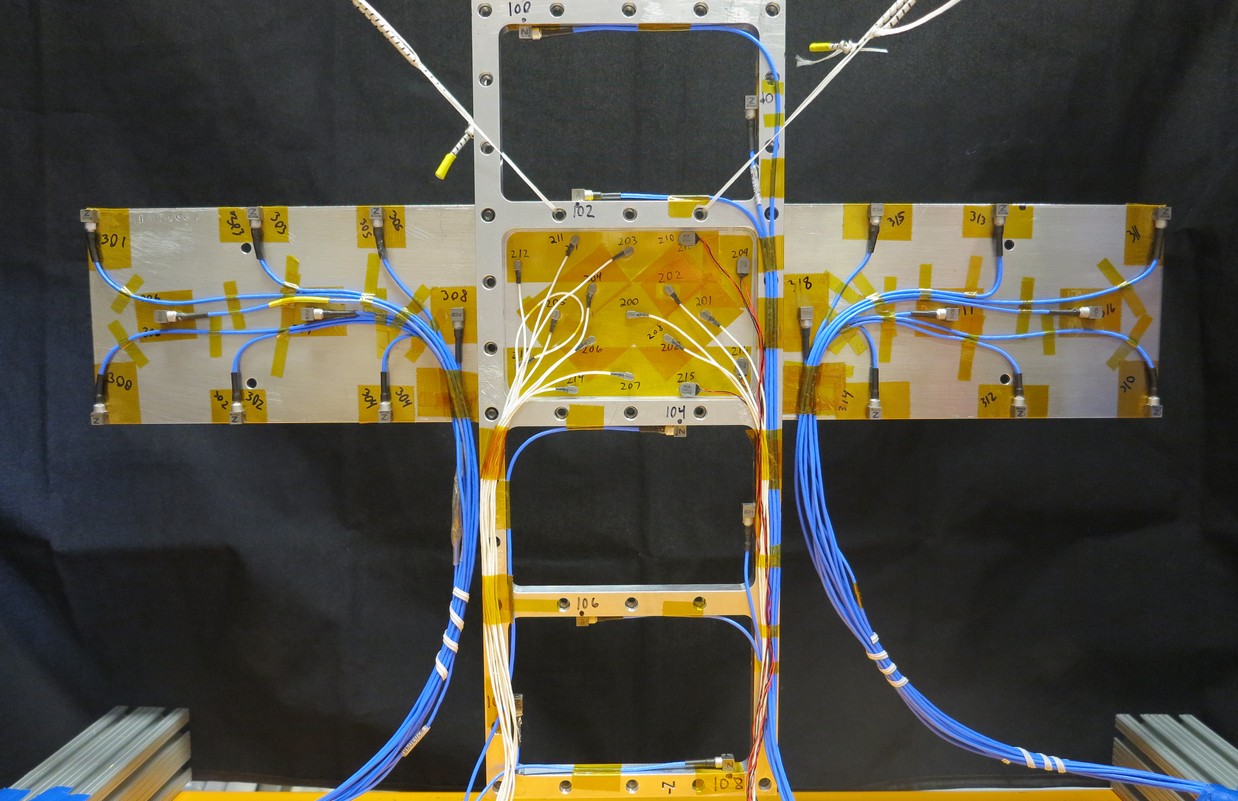
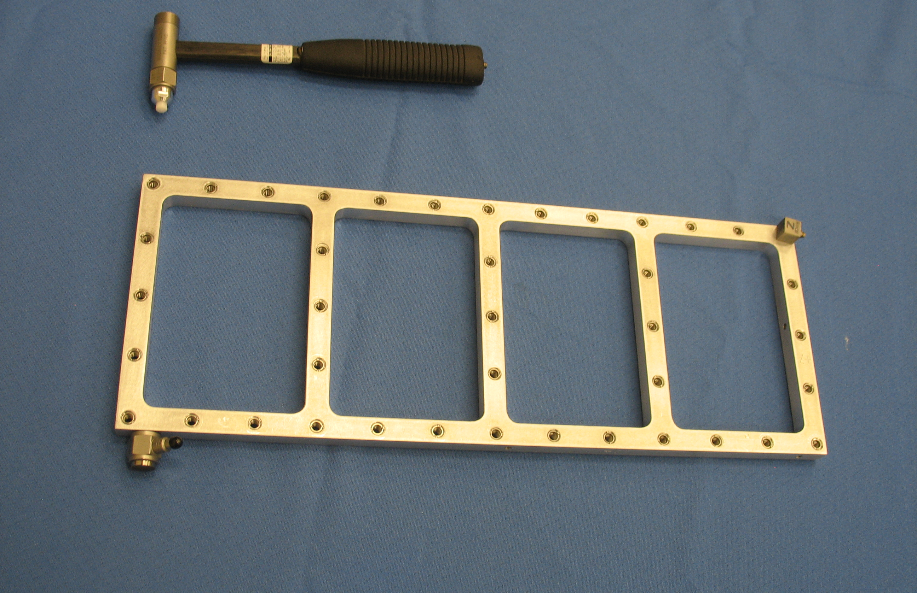
Estimated Agenda
Module # | Title | Planned Timing
1 | Introduction | 9:00-9:20
2 | Physical Coupling | 9:20-10:00
3 | Frequency Based Substructuring | 10:00-10:40
- | Break | 10:40-10:50
4 | Component Mode Synthesis | 10:50-11:20
5 | In Class Exercises I | 11:20-Noon
- | Lunch | Noon-1:00
6 | Experimental Considerations | 1:00-1:45
7 | Frame Wing Experimental Example | 1:45-2:30
- | Break | 2:30-2:40
8 | Transfer Path Analysis | 2:40-3:10
9 | Virtual Point Transformation | 3:10-3:40
10 | Decoupling | 3:40-4:10
11 | Nonlinear Component Mode Synthesis | 4:10-4:40
12 | Course Conclusions | 4:40-5:00

Slide 4
Informal Survey
Have you:
Had an undergraduate-level class on vibrations?
Had a graduate-level class on vibrations?
Had a graduate-level class on finite element analysis? Experience with FEA?
Ever performed a modal test? Regularly?
Introductions:
Who are you – where are you from?
How do you hope that this course might benefit your work?
Approach for this short course
80% Lecture , 20% Guided exploration

Slide 5
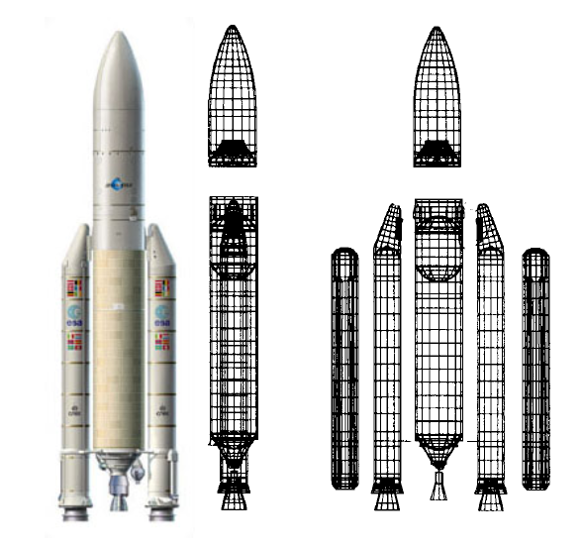
What Is Substructuring?
Substructuring is a process whereby individual components of a structure are analyzed or tested separately and then combined to predict the response of the built-up structure.
Reduced Order Modeling: create an approximation to a model to reduce the computational burden
Analytical substructuring forms the basis of the Finite Element Method, and related techniques, such as the Craig-Bampton method, have been key components of structural analysis for over 40 years.

Slide 6
What is Experimental/Analytical Substructuring?
Experimental/Analytical Substructuring is a far less common variant where a model for one or more subcomponents is derived experimentally.
Often we are tasked with analyzing systems where one or more components are difficult to model analytically
Unknown material properties
Complicated Geometry
Produced and designed by an outside vendor
The dynamics of these parts can have profound impact on the system level performance
Experimental models are often the optimal choice for characterizing the impact of non modeled hardware it’s the system level response
Experimental-analytical substructuring allows one to couple experimental results from these test to high fidelity finite element models

Slide 7
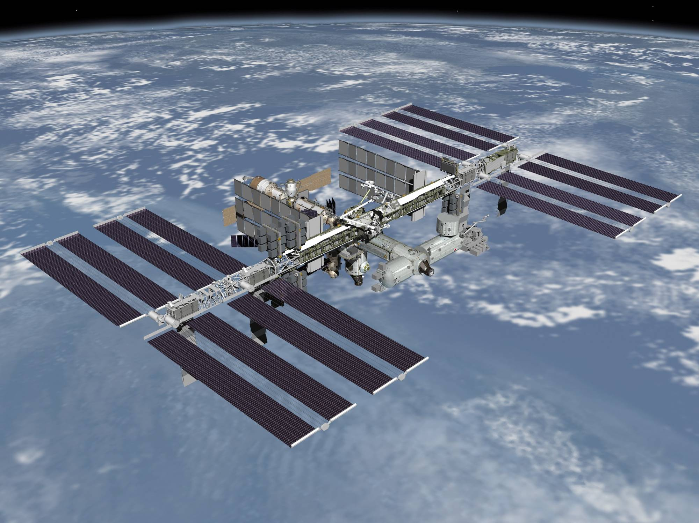
Some systems cannot be assembled until it is too late!
Other Examples:
New Automobiles
Aircraft
…

Slide 8
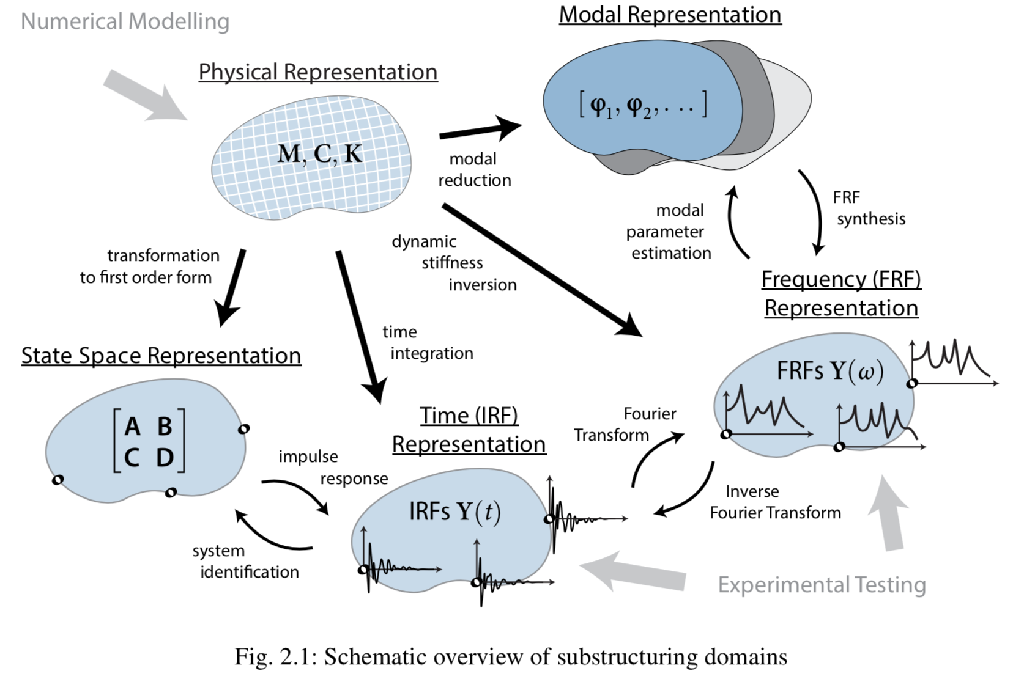
Domains for Substructuring

Slide 9
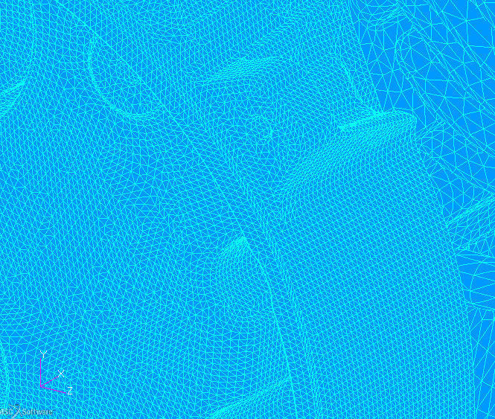
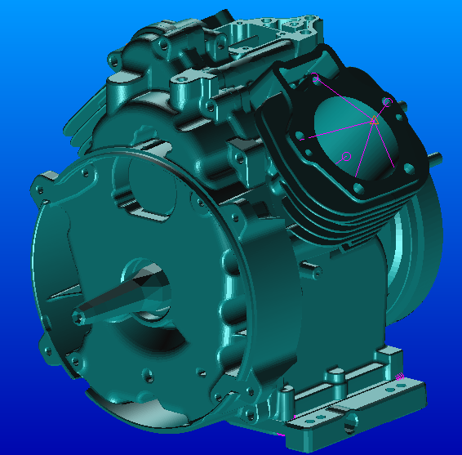
Relation to Reduced Order Modeling
A complete FEA model allows for arbitrary motion of any node of the structure.
A substructure or reduced order model can be more efficient by capturing only those motions that are likely in the application of interest.
This is especially relevant to structural dynamics, where the deformations observed are often the net effect of only a few vibration modes.

Slide 10
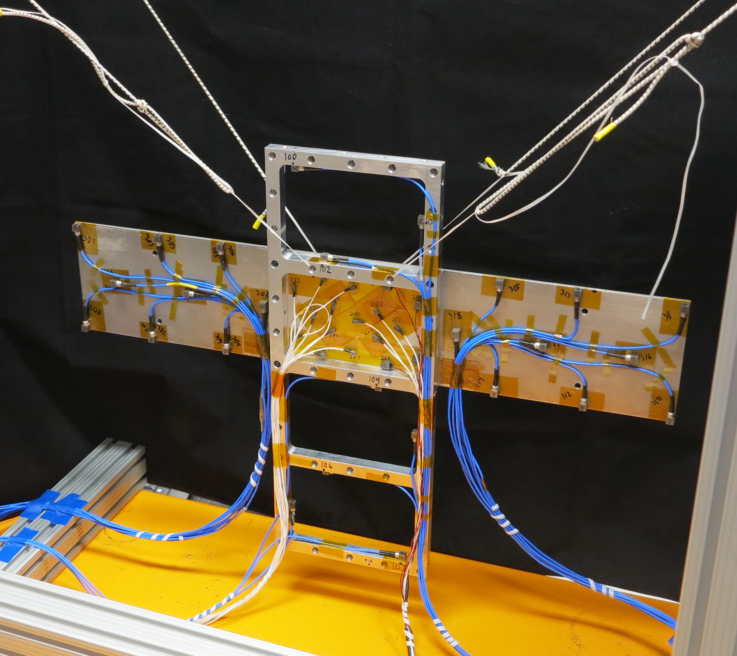
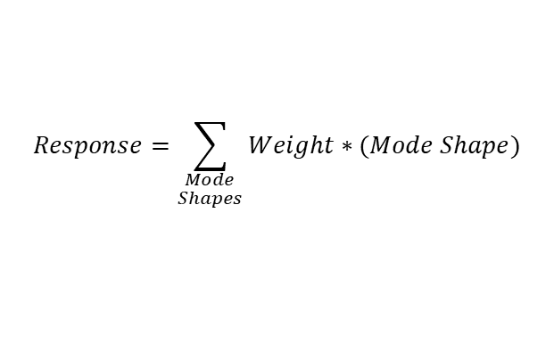
What are modes?
Modes are inherent physical properties of all objects
Describe how objects naturally respond to stimulation at different frequencies
The fundamental building blocks of all complex dynamic response
All complex dynamic behavior is a linear superposition of modal responses
$$Response=\sum_{\begin{aligned}Mode \\ Shapes\end{aligned}}{Weight∗(Mode Shape)}$$
Response
=
Mode 1
Individual Modal Deflection Shapes
+
Mode 2
+
Mode 3
…

Slide 11
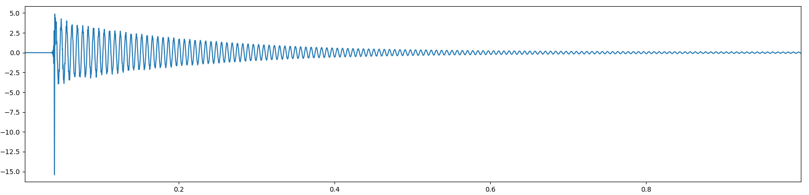
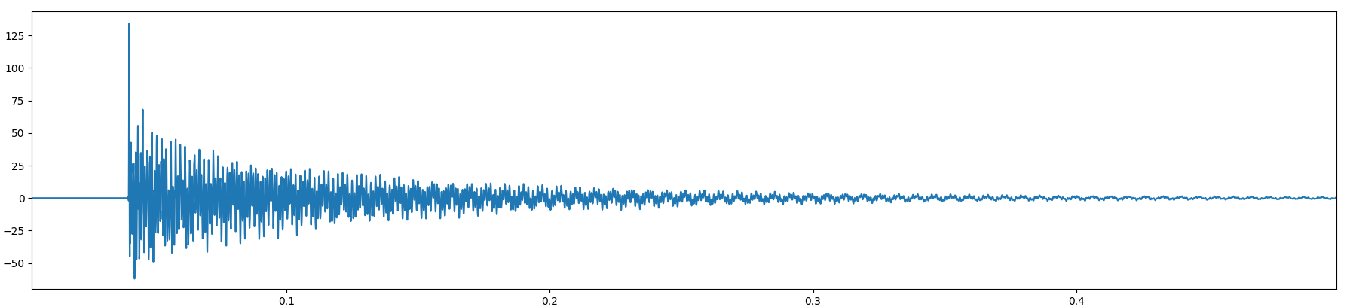
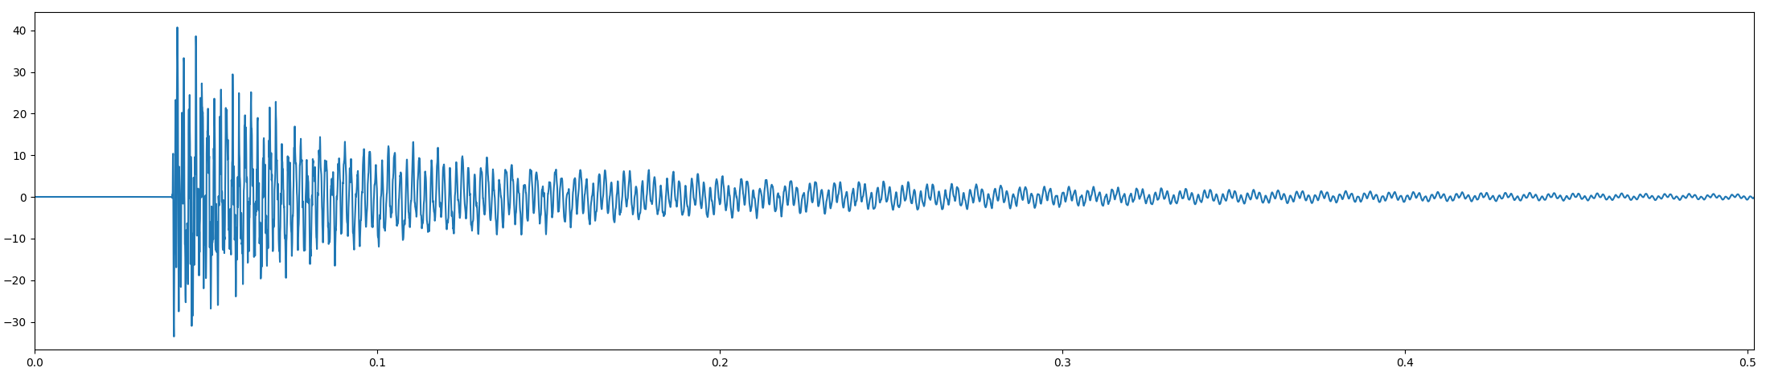
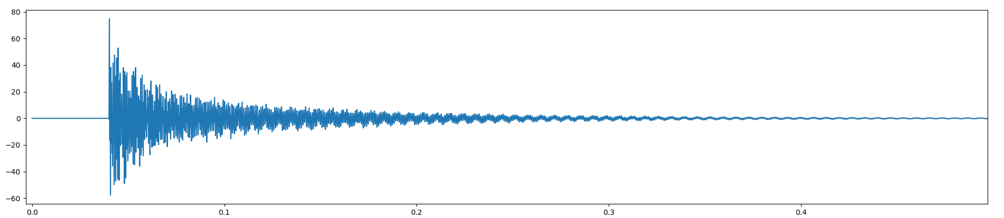
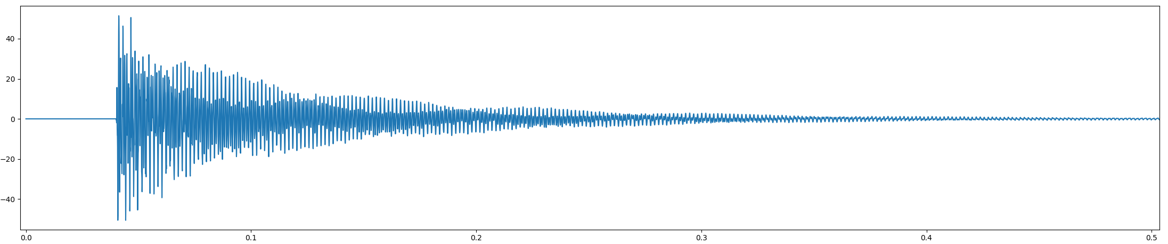
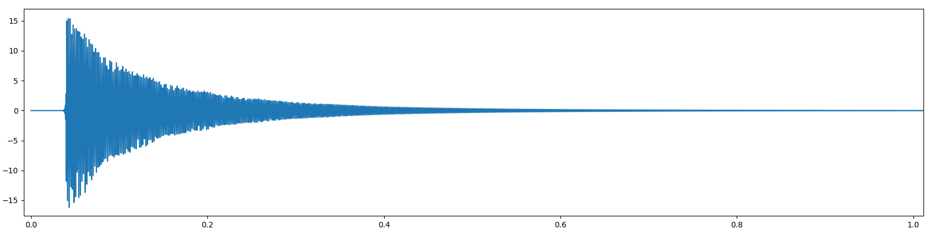
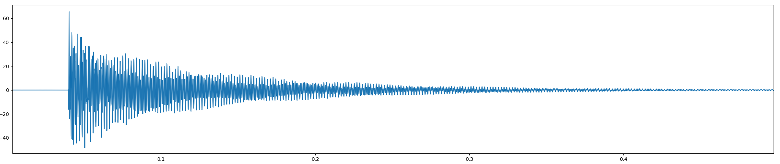
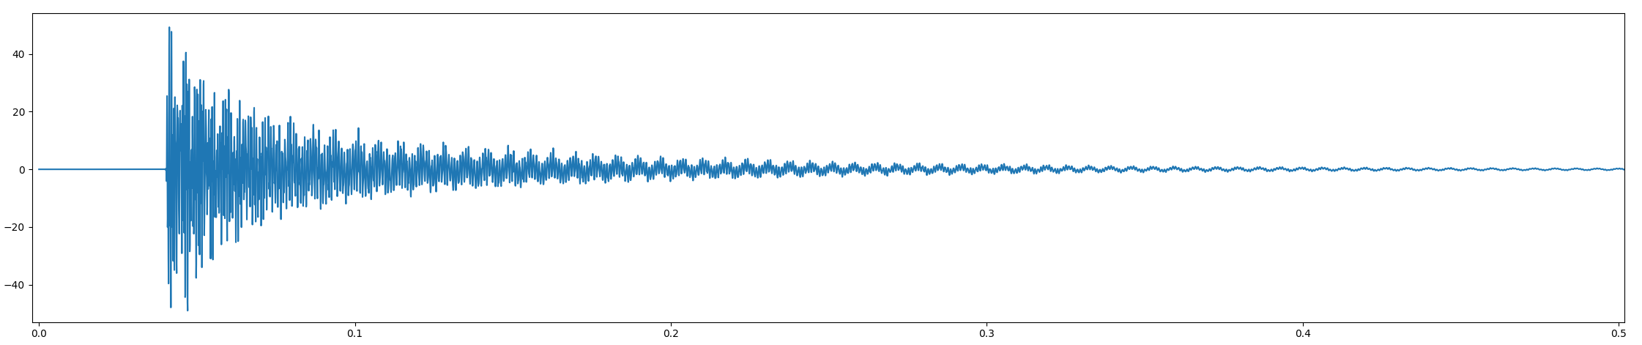

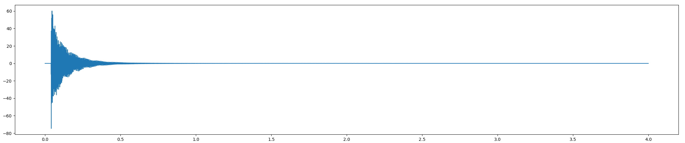
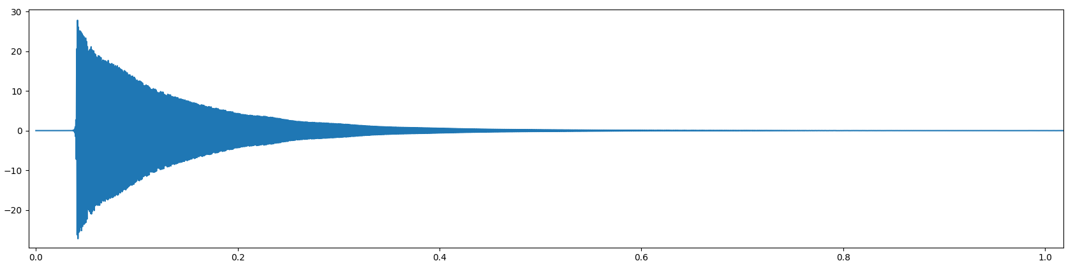

What about model reduction?
We take many responses in the physical domain…
Modal Domain
Physical Domain
Sensor 101
Sensor 105
q1 Response
Sensor 102
Sensor 106
Sensor 103
Sensor 107
q2 Response
$$x=φq$$
Sensor 104
Sensor 108
q3 Response
Time [s]
and apply a modal transformation to convert to the modal domain.
With these basic structural dynamics principles in mind we are ready to begin coupling systems and learning about substructuring

Slide 12
Next Up – Physical Coupling

